Slide 1
smartTrade: Integration BUS (IBUS) 6.0.x.x Concepts and API overview

Slide 2
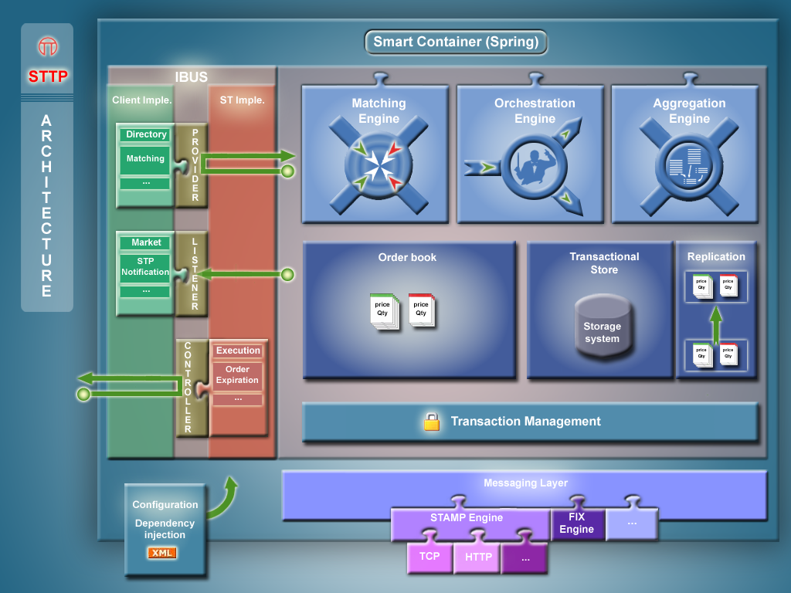
Extension API

Slide 3

Dependencies Injection
. .:
Integration BUS (IBUS)
Spring based, modular architecture, easy integration
Programming by contract
Provide clearly defined and type-checked extension point
Allows to replace default components by customized implementations
Offers a way to create assemblies of components
Rely on the Common Data Model
3 types of components
Providers : Requested by STTP to provide Information ( SpreadProvider…)
Listeners : Receive callback from the application ( MarketListener…)
Controllers : Allows to interact with STTP internal objects (ExecutionController ...)

Slide 4
Interfaces
IBUS components are Java interfaces
Provider : to be implemented externally
. .:
/**
* Providers are called by STTP for data feeding. This interface specifies ST users/usergroups.
*/
public interface DirectoryProvider {
/**
* Gets all users.
*
* @return all the users
*/
public List<User> getAllUsers() throws ServiceException;
/**
* Gets all groups.
*
* @return all the groups
*/
public List<UserGroup> getAllUserGroups() throws ServiceException;
/**
* Gets a user based on its id.
*
* @param userId
* the id of the user to retrieve
* @return the user if found else null
*/
public User getUser(UserID userId) throws ServiceException;

Slide 5
Interfaces
Listener: to be implemented externally
. .:
/**
* Notification when a message is incoming/outgoing inside STTP
*/
public interface RemotingMessageListener {
/**
* A message is sent to STTP.
*
* @param msg
* incoming message
*/
void onIncomingMessage(Message msg);
/**
* A message is sent from STTP.
*
* @param msg
* outgoing message
*/
void onOutGoingMessage(Message msg);
}

Slide 6
Interfaces
Controller : to be used externally
. .:
/**
* Controllers are used in order to interact inside STTP. This interface allows to suspend/resume
* the execution of the matching engine.
*/
public interface ExecutionController {
/**
* Suspend the execution of the matching engine for all the securities
*/
public void suspendExecution();
/**
* Resume the execution of the matching engine for all the securities
*/
public void resumeExecution();

Slide 7
Configuration
Inject your bean implementations in sttp.xml
<bean id="directoryProvider" class="com.smarttrade.ibus.my.MyDirectoryProvider" >
<property name="sourceFile" value="etc/users.xml" />
</bean>
<!-- override existing one -->
<bean class="com.smarttrade.ibus.my.MyMailStpNotificationListener">
<property name="targetAddresses">
<list>
<entry name="backoffice@worldcompany.com" />
<entry name="supervisor@worldcompany.com" />
</list>
</property>
</bean>
<!-- autowired, by type -->

